Slide 1
WEEK 4
Python In Hacking

Slide 2
This week…
How passwords are stored
What is Hashing
How to crack Hashes
Tools you’ll need

Slide 3
How are passwords stored?
Storing in plaintext
Not secure
Easy for any attacker to use in case of a data breach.
Storing password hashes
Passwords are not stored as plaintext, therefore secure.
Even in case of a data breach, attackers only get the hash of the password. They’ll still have to crack it.

Slide 4
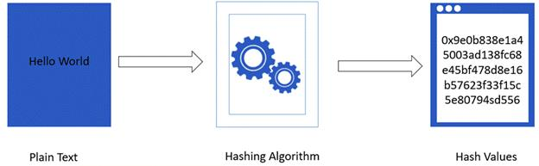
What’s a hash?
Function
Takes in plaintext, outputs hash digest.

Slide 5
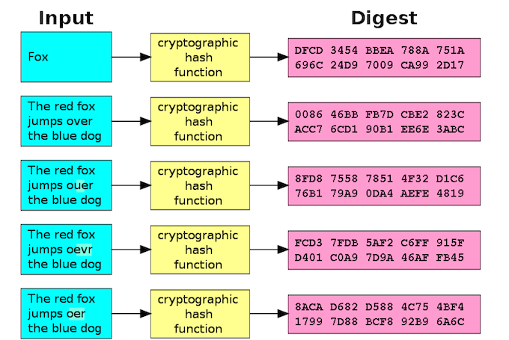
What’s a hash?

Slide 6
Basically: No way to compute plaintext from hash. We can, however, crack hashes. How?

Slide 7
Hash given: 22afa354 Possible plaintext: hello Hash of ‘hello’: 54ae3e38 Nope. Possible plaintext: pass Hash of ‘pass’: 22afa354 Yep. Password is ‘pass’. Hash has been cracked!

Slide 8
Types of password attacks
Brute Force Attack
Dictionary Attack
Rainbow Tables
Social Engineering
Malware (keyloggers)
Guess

Slide 9
Brute Force Attack
Try ALL possible combinations of letters
It WILL find the password. But runtime might be in centuries
For a 8 character UNIX password:
Try out all combinations. 256⁸ possibilities.
But only if all letters are equally likely.
Passwords now a days go well over eight characters!

Slide 10
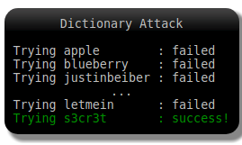
Dictionary Attack
People tend to have names of pets or loved ones as passwords.
Passwords like qwerty or password123 are common.
Instead of all permutations, use a dictionary of common/possible passwords to crack hash

Slide 11
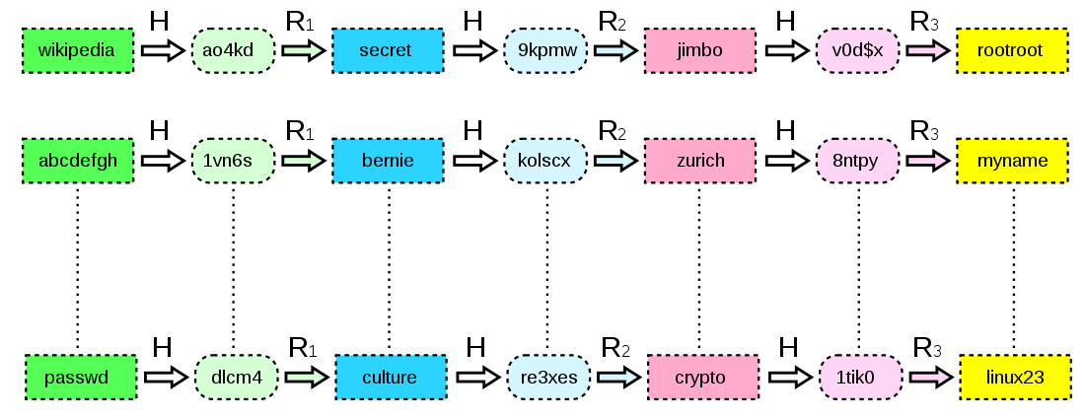
Rainbow Tables
When the hashing algorithm is time consuming
Or processor isn’t great
Rainbow table, over simplified, is a table of hashes and their corresponding plaintext
Rainbow Tables take up a lot of space
Fast

Slide 12

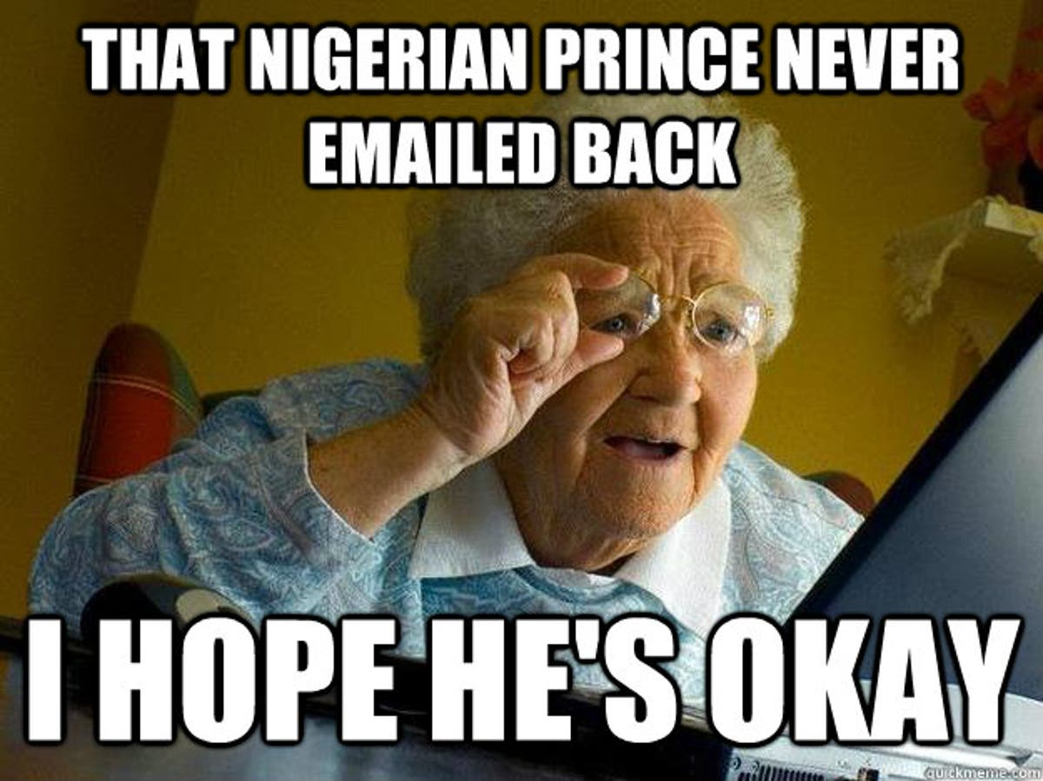
Social Engineering
Shoulder surfing
Phishing
Social engineering is given waayy less credit in popular media than it deserves!
33% of data breaches in 2020 involved social engineering*
*Source: https://purplesec.us/resources/cyber-security-statistics/#:~:text=Recent%20data%20breach%20statistics%20found,data%20breach%20is%2025%2C575%20records.

Slide 13
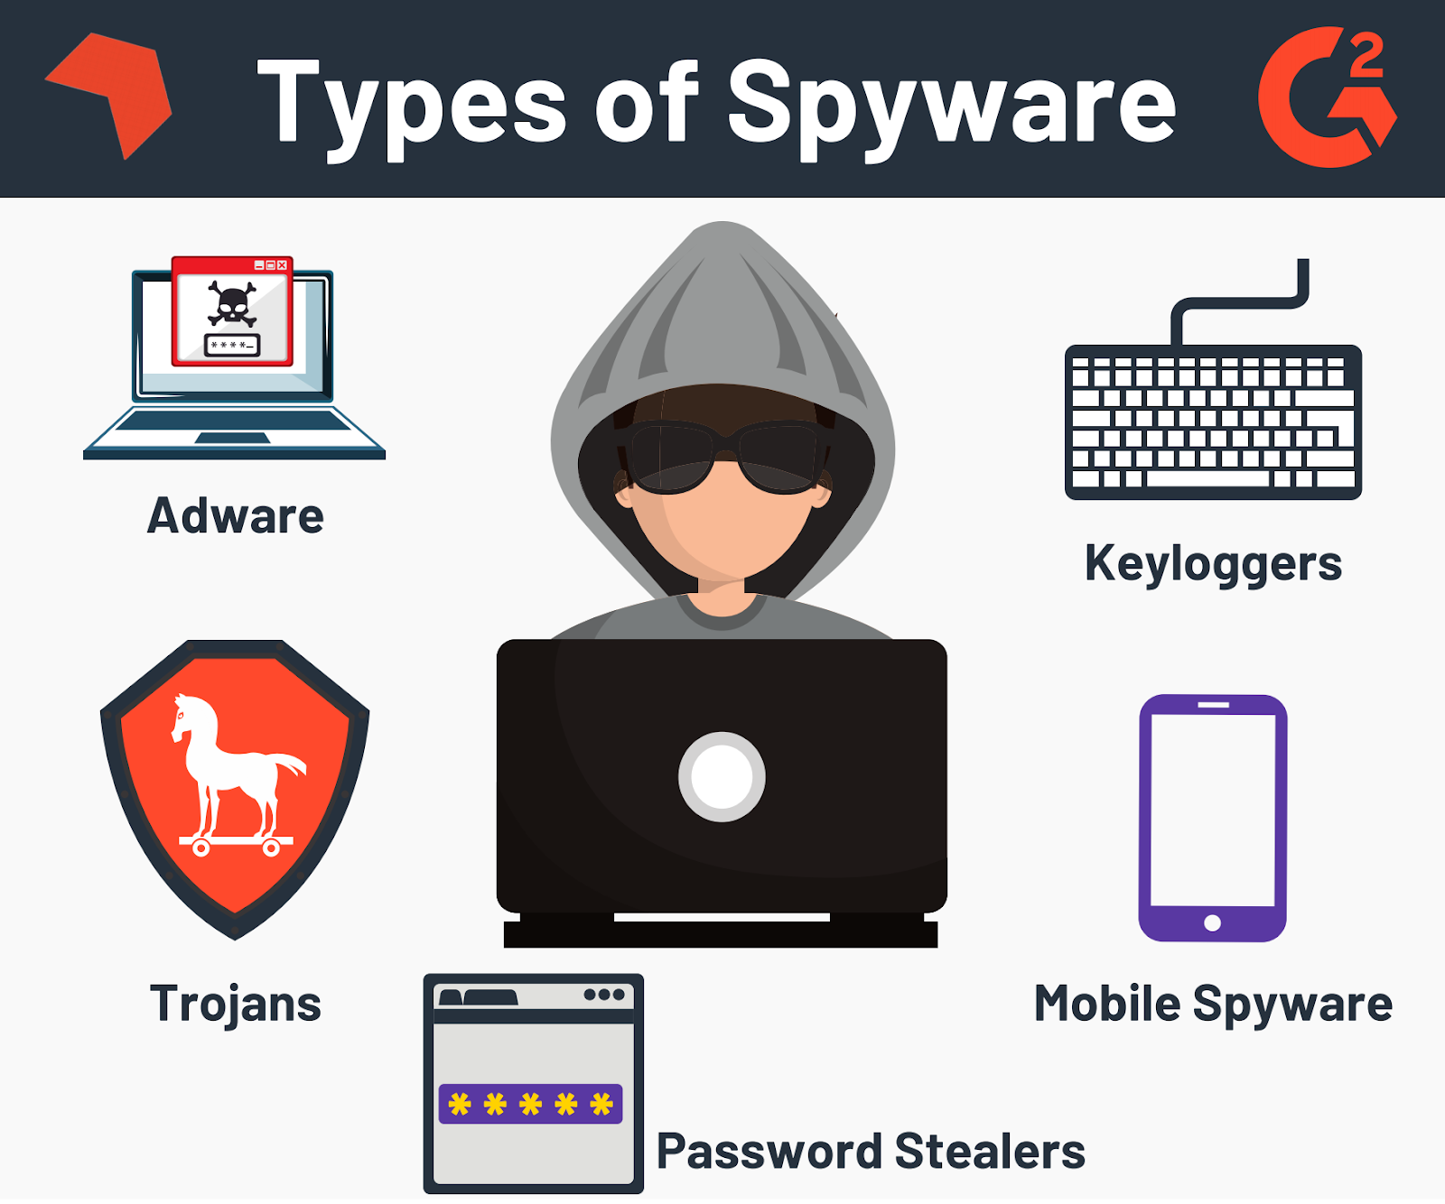
Malwares
Malwares like keyloggers log keystrokes on the target machine and send it to the attacker

Slide 14
Tools
hashlib
Installation: pip install hashlib
Secure hash and message digest library
Provides SHA-224, SHA-256, SHA-384, SHA-512 hash algorithms along with optimized versions of MD5 and SHA-1
re
Installation: pip install regex
Regex library for python
Build password crackers and attack online login forms

Slide 15
Thank You
Python in Hacking

